Slide 1
Paragraph Structure, Topic Sentences, Transitions
Creating and Using Writing Outlines
Science Writing Resources for Learning
scwrl.ubc.ca

Slide 2
Learning Objectives
By the end of these in-class activities, you should be able to:
Create a writing outline to help organize ideas and structure a piece of writing
Use the writing outline to help draft the piece of writing
Improve the piece of writing by forming paragraphs and topic sentences and by using transition words and phrases

Slide 3
Activity 1
(work together, then alone, 15 minutes)
You have been asked to write a short answer (approximately 200 – 300 words) to the prompt:
What is a simple science experiment, and which skills are needed to work effectively with other people when performing one?
[Together] Discuss some of the things you would like to include in your answer
[Alone] Write a short answer to the
prompt

Slide 4
Activity 2
(work together, 15 minutes)
Try to create a writing outline to better answer the previous prompt. It should be numbered, and look like a contents page in a book once you have worked through 1 – 5 below:
Determine the purpose of the answer, and your audience
Brainstorm the ideas you want to include in your answer
Group related ideas together (these will form paragraphs)
Order the information that will go in each paragraph from general to specific
Devise sub-headings for each paragraph (you can turn these into topic sentences later)

Slide 5
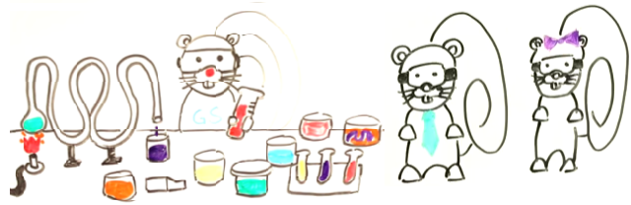
Activity 2: Sample Solution
Prompt: What is a simple science experiment and which skills are needed to work effectively with other people when performing one?
Paragraph 1: Introduction
i: Define and provide an example of a simple experiment
Paragraph 2: Skills needed to work with others
i: Defend that performing a simple science experiment requires special skills
ii: Examples of skills needed to work with others
iii: Defend that these are specific to working with others
iv: Link these skills to simple science experiments to put them into context

Slide 6
Activity 3
(work alone, then together, 15 minutes)
Now use your outline to re-write a short answer to the prompt: What is a simple science experiment and which skills are needed to work effectively with other people when performing one?
Hints
Organize ideas into the different paragraphs
Order information in each paragraph from general to specific
Once you have your first draft, replace sub-headings for each paragraph with a topic sentence
Then add in transition words and phrases to link each sentence with the next one

Slide 7
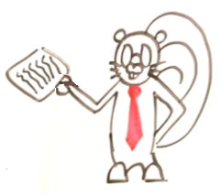
Activity 4
(work together, remaining time)
Read the short answer you have just written, and then re-read your initial answer (the one you wrote in Activity 1)
Discuss the difference in quality with your partner/partners.
If you have time, exchange written answers and comment on the progression you have made
Before leaving, collect a copy
of a suggested solution from
your instructor

